Slide 1
Intro to phpXampp
Installing and using php Xampp

Slide 2
Today's Overview
Git Exercise
Install phpMyAdmin
php Exercise
Notes:
Source: http://en.wikipedia.org/wiki/Model%E2%80%93view%E2%80%93controller#mediaviewer/File:MVC-Process.svg
<number>

Slide 3
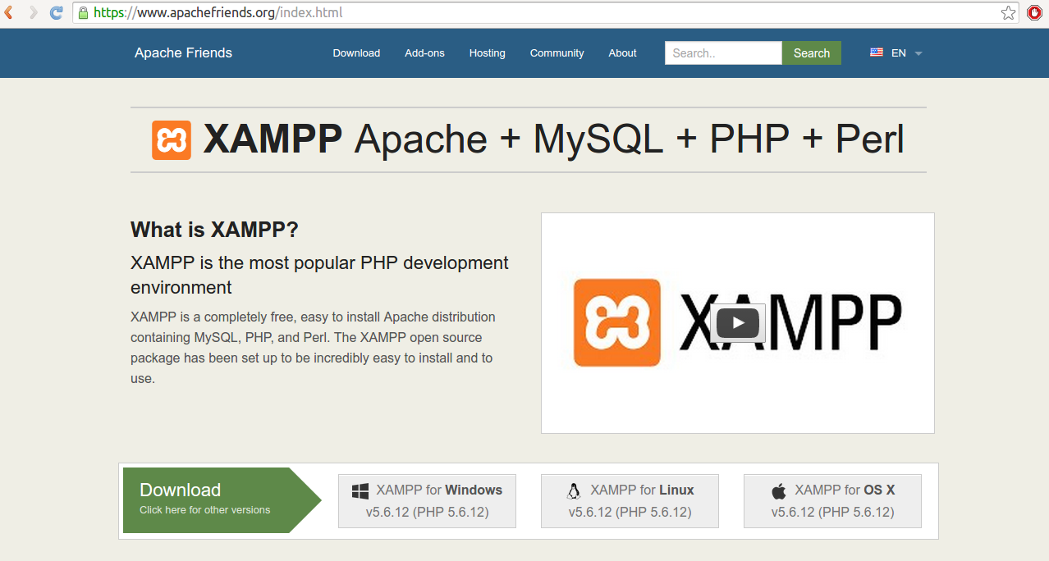
Get XAMPP
Go to www.apachefriends.org

Slide 4




The World Wide Web
Notes:
<number>

Slide 5
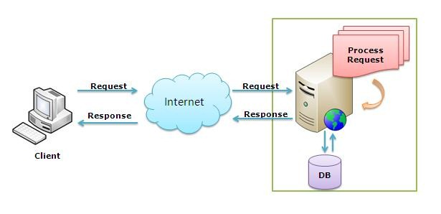
The World Wide Web
Notes:
<number>

Slide 6
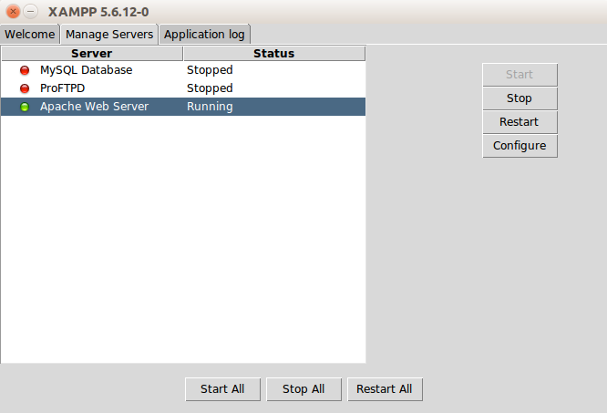
Start XAMPP
Notes:
/opt/lampp/lampp start

Slide 7
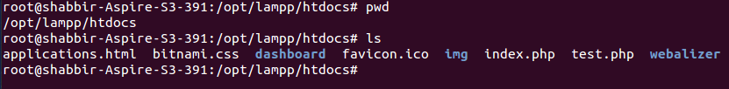
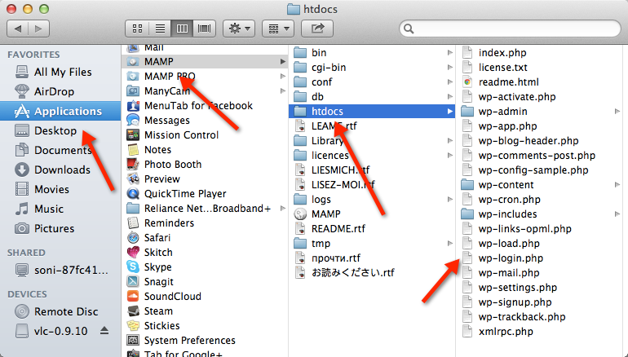
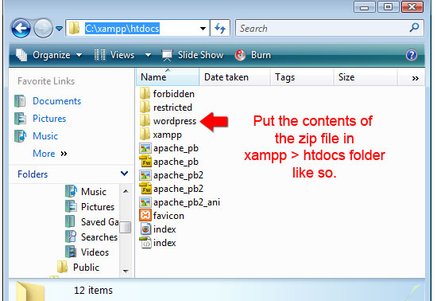
Go to htdocs
Notes:
Source: http://en.wikipedia.org/wiki/Model%E2%80%93view%E2%80%93controller#mediaviewer/File:MVC-Process.svg
<number>

Slide 8
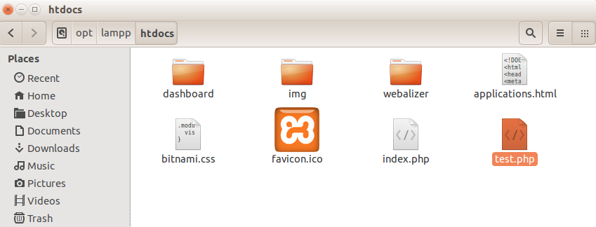
Create PHP file
Notes:
Source: http://en.wikipedia.org/wiki/Model%E2%80%93view%E2%80%93controller#mediaviewer/File:MVC-Process.svg
<number>

Slide 9
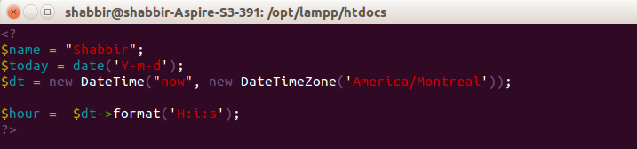
Insert Test code
Notes:
Source: http://en.wikipedia.org/wiki/Model%E2%80%93view%E2%80%93controller#mediaviewer/File:MVC-Process.svg
<number>

Slide 10
References
1. http client: http://www.mkyong.com/java/how-to-send-http-request-getpost-in-java/
2. xampp and php examplehttps://www.youtube.com/watch?v=lB9aKoFjwkg

